Slide 1

Pioneer Trust Bank SQL-Based Fraud Detection in Banking
Osaroh Ekhoragbon
May 19, 2025

Slide 2

Business Overview
Pioneer Trust Bank is a financial institution facing a surge in fraudulent activities across customer transactions. The existing fraud detection system is inadequate for real-time analysis, leading to financial loss and reduced customer trust.
This project applies SQL-based analytics on historical transaction data to identify high-risk activities and deliver strategic insights for fraud prevention.
This demonstrates the potential of structured SQL analysis in driving actionable risk mitigation strategies for the banking industry.

Slide 3
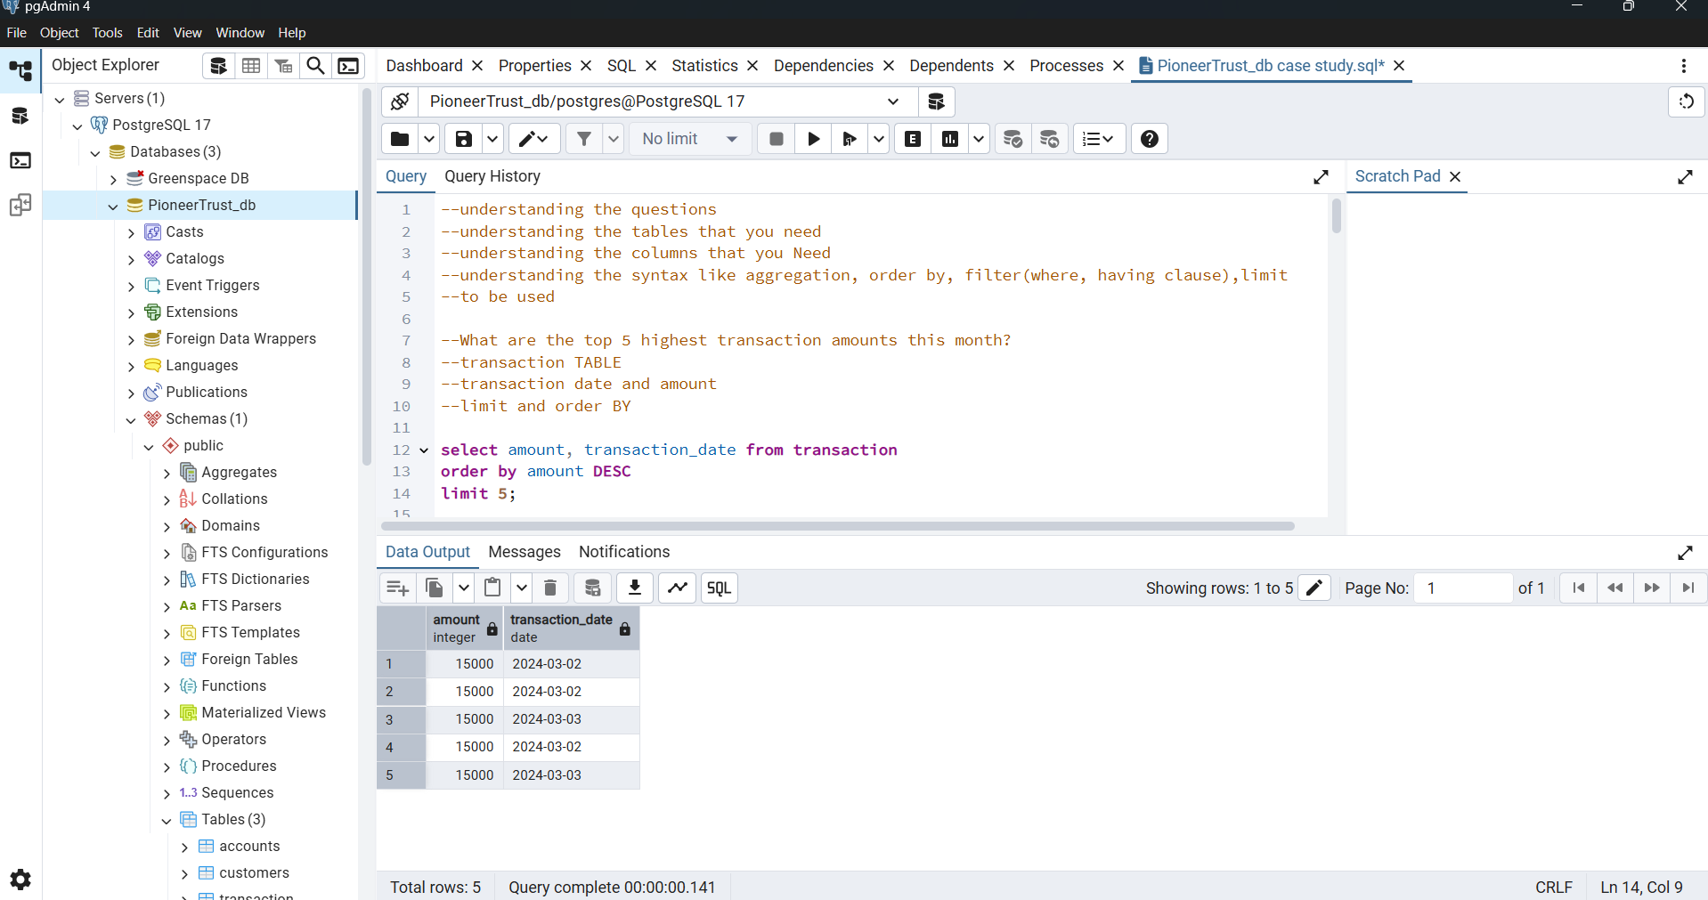
High Transaction Amounts

Slide 4
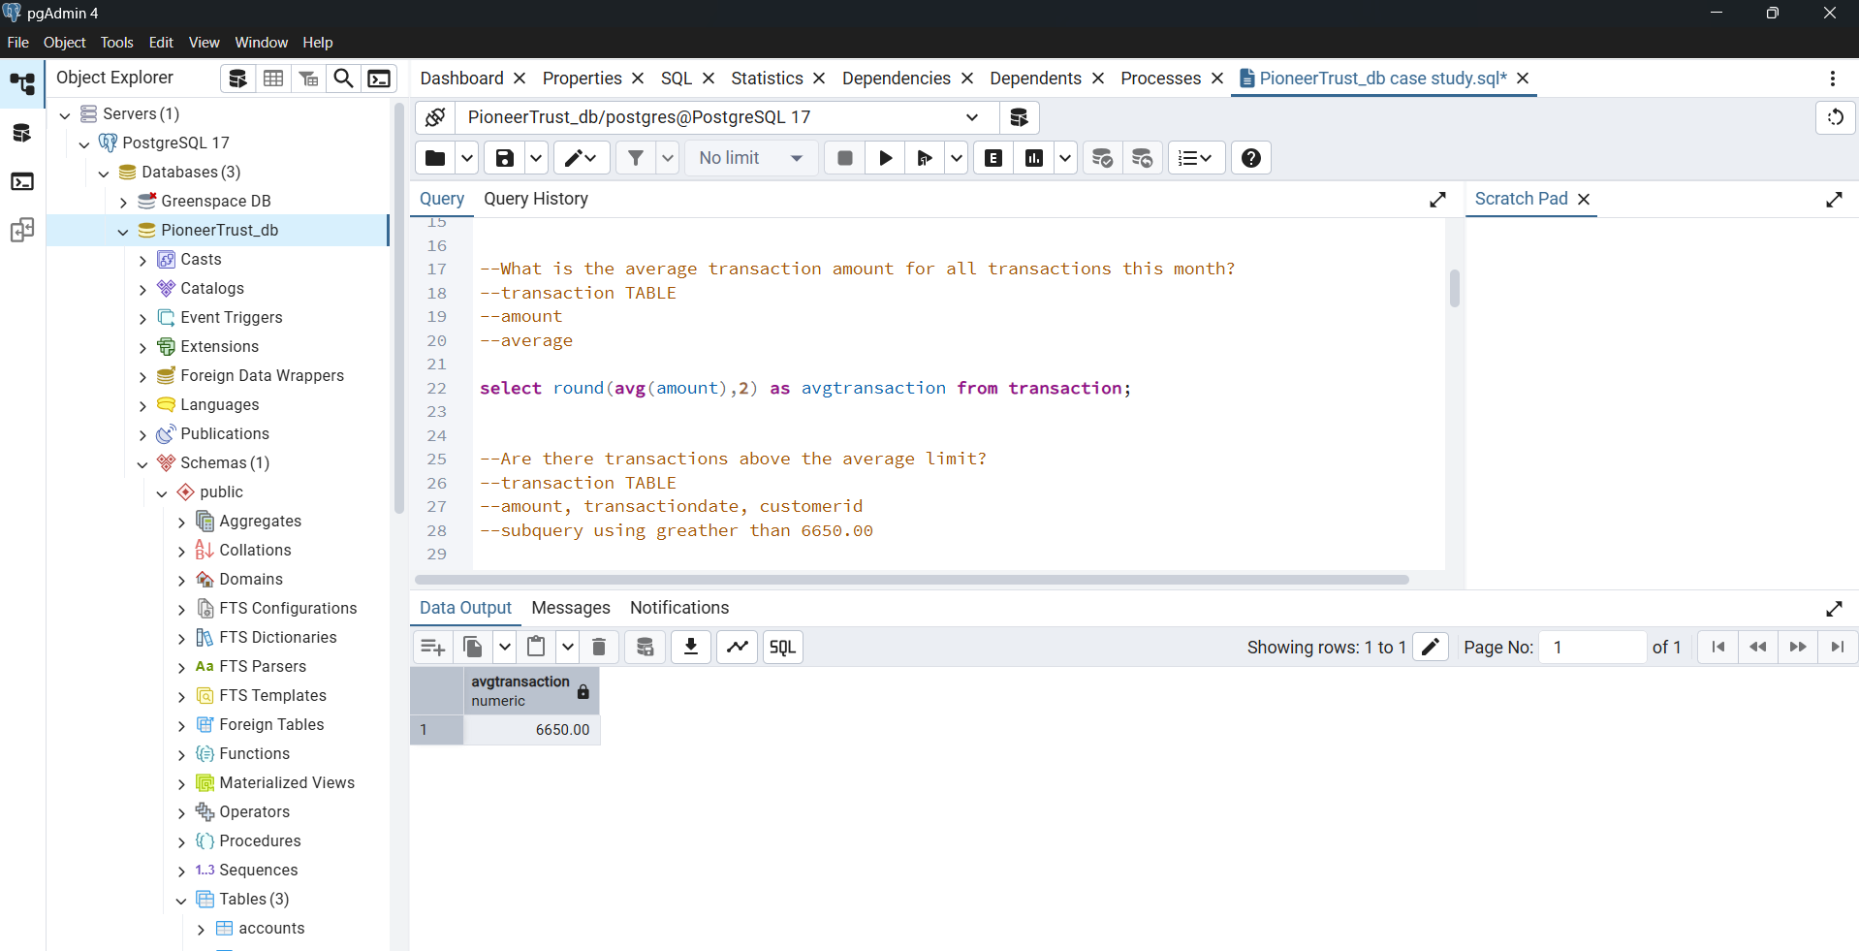
High Transaction Amounts

Slide 5
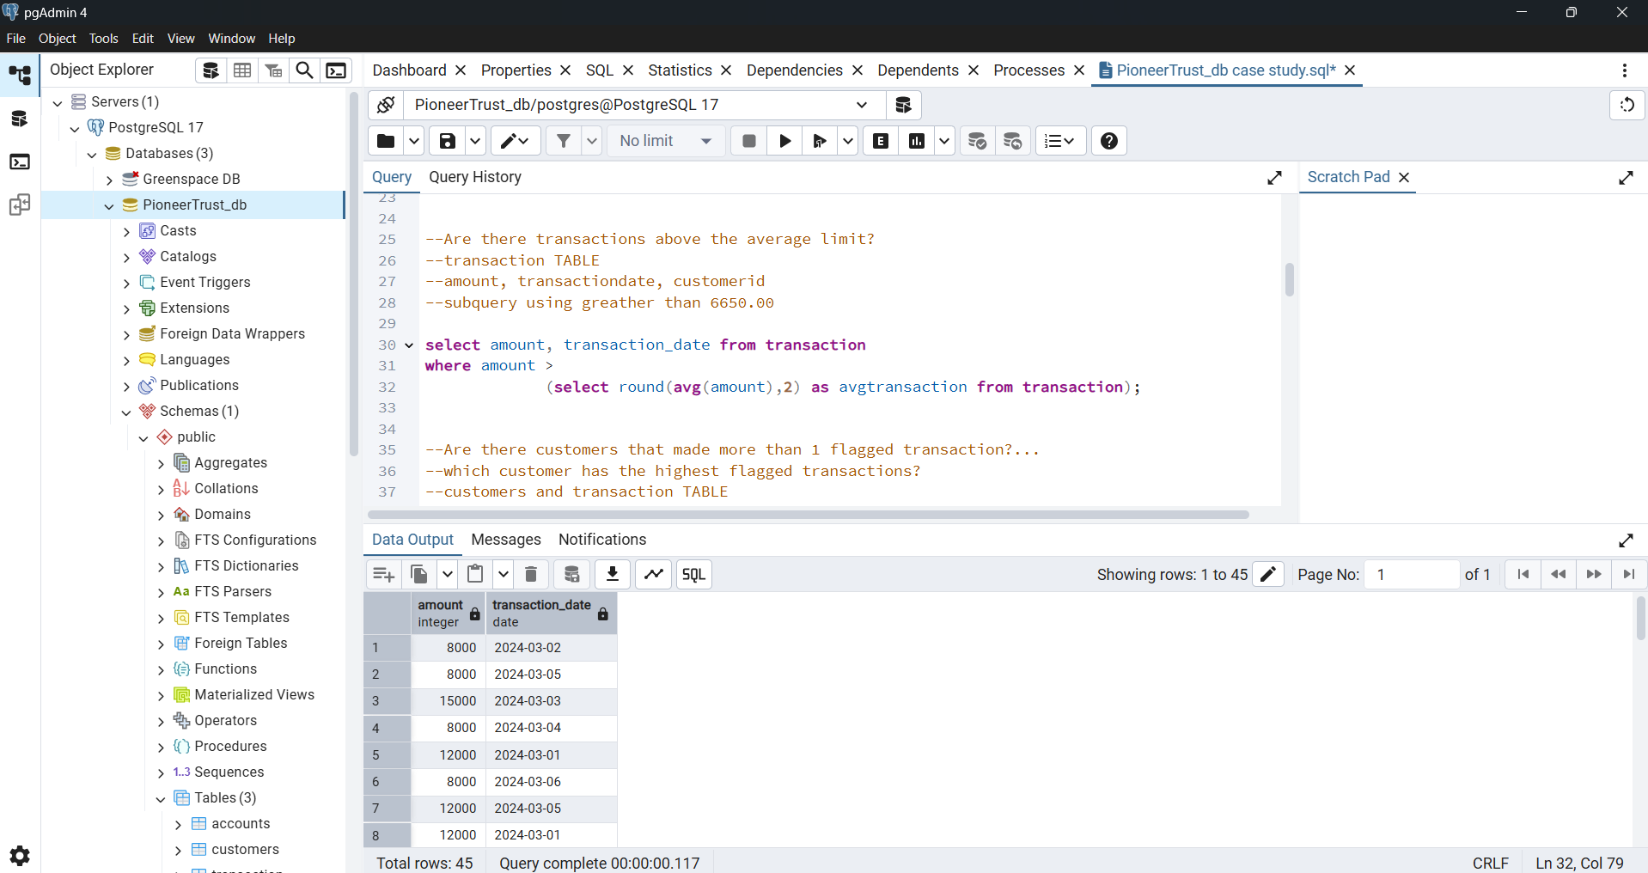
High Transaction Amounts

Slide 6

Insight: High Transaction Amounts
Objectives: Identify unusually large transactions to detect potential fraudulent behavior.
Findings:
The top 5 transactions, each valued at ₦15,000, revealed repeated high-value activities.
The average transaction was ₦6,650 – transactions above this were flagged.
Several transactions exceeded the average transaction limit, indicating high-value outliers.
Recommendation:
Set automated alerts for transactions exceeding the 2x average threshold.
These thresholds can be tailored to customer type and account profile.

Slide 7
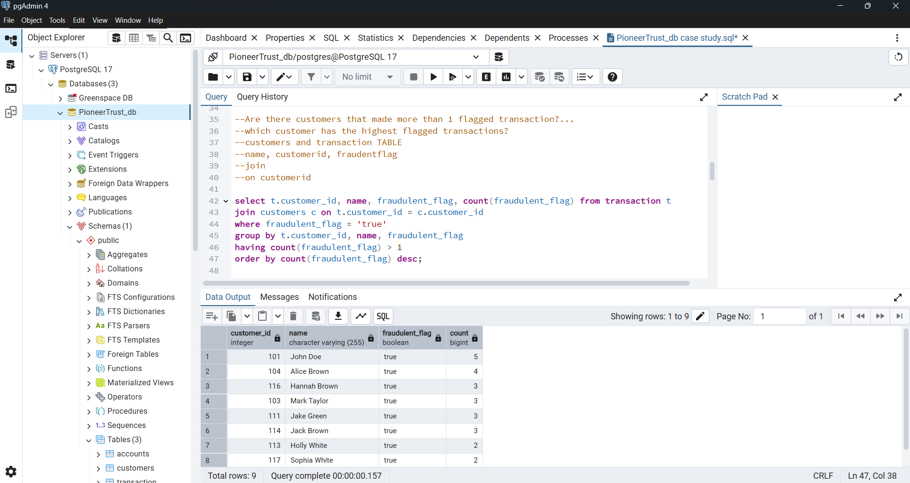
Repeat Offenders

Slide 8
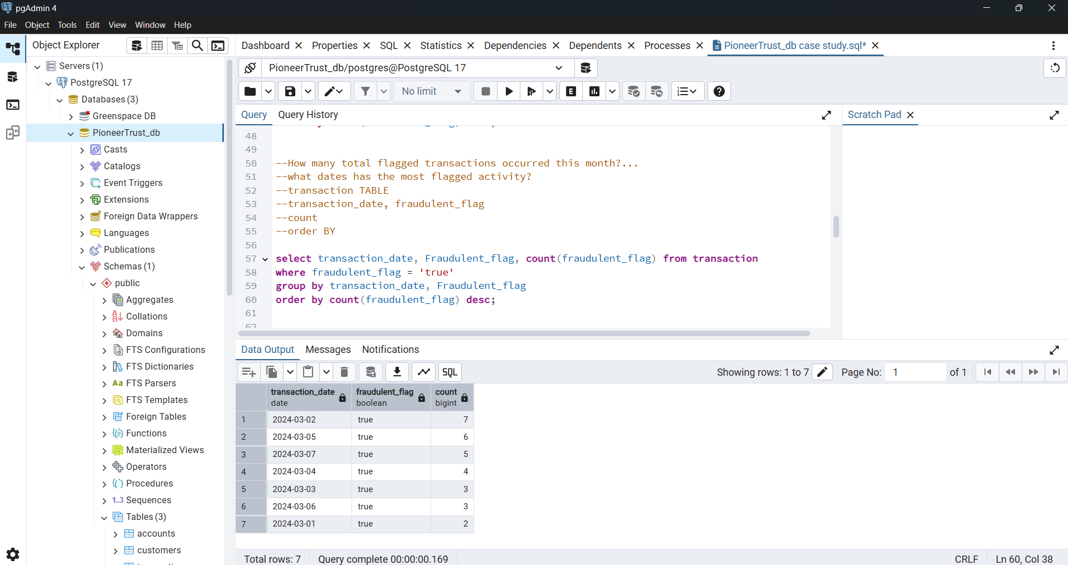
Repeat Offenders

Slide 9
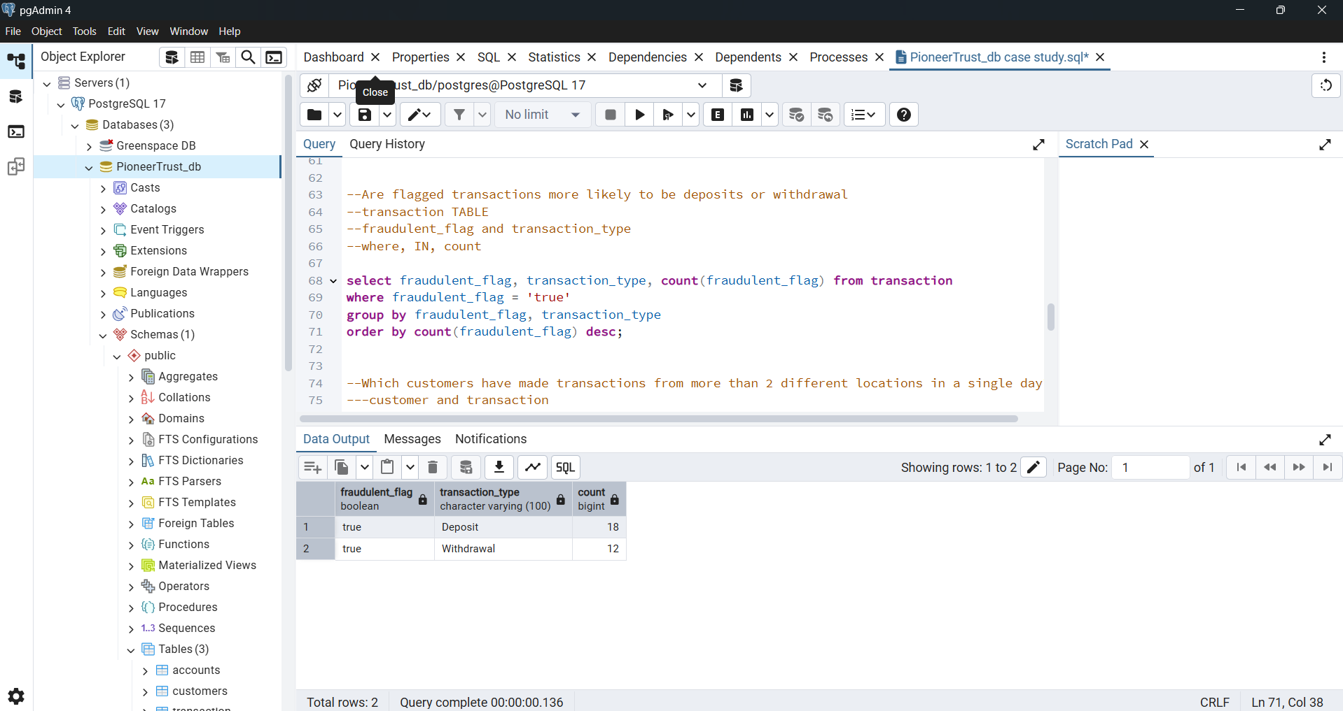
Repeat Offenders

Slide 10

Insight: Repeat Offenders
Objectives: Detect customers with multiple flagged transactions.
Finding:
Multiple customers triggered repeated fraud flags. Notably, one customer (John Doe) had 5 flagged transactions, showing a pattern of repeated suspicious activity.
Flagged transactions were more frequent on specific dates, notably March 2nd.
Deposits were more commonly flagged than withdrawals—highlighting where monitoring should be stricter.
Recommendation:
Monitor high-frequency fraud customers with enhanced scrutiny.
Implement profiling of frequent offenders with real-time blocking triggers.
Review KYC data and transaction histories of flagged deposits and withdrawals.

Slide 11
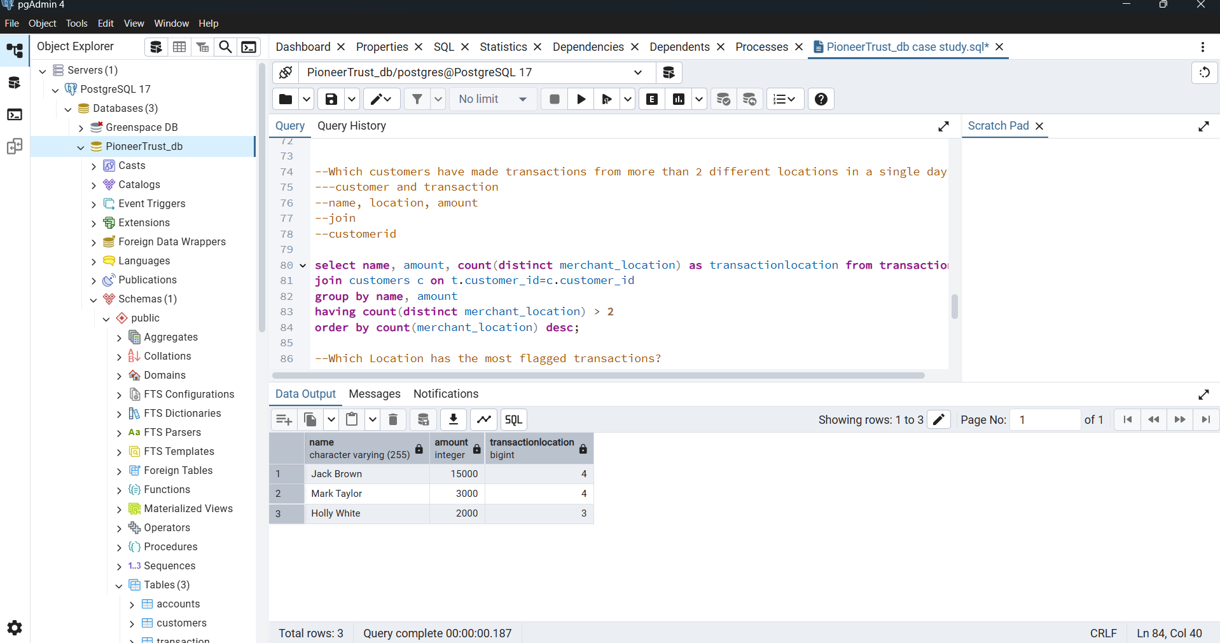
Transactions from Multiple Locations

Slide 12
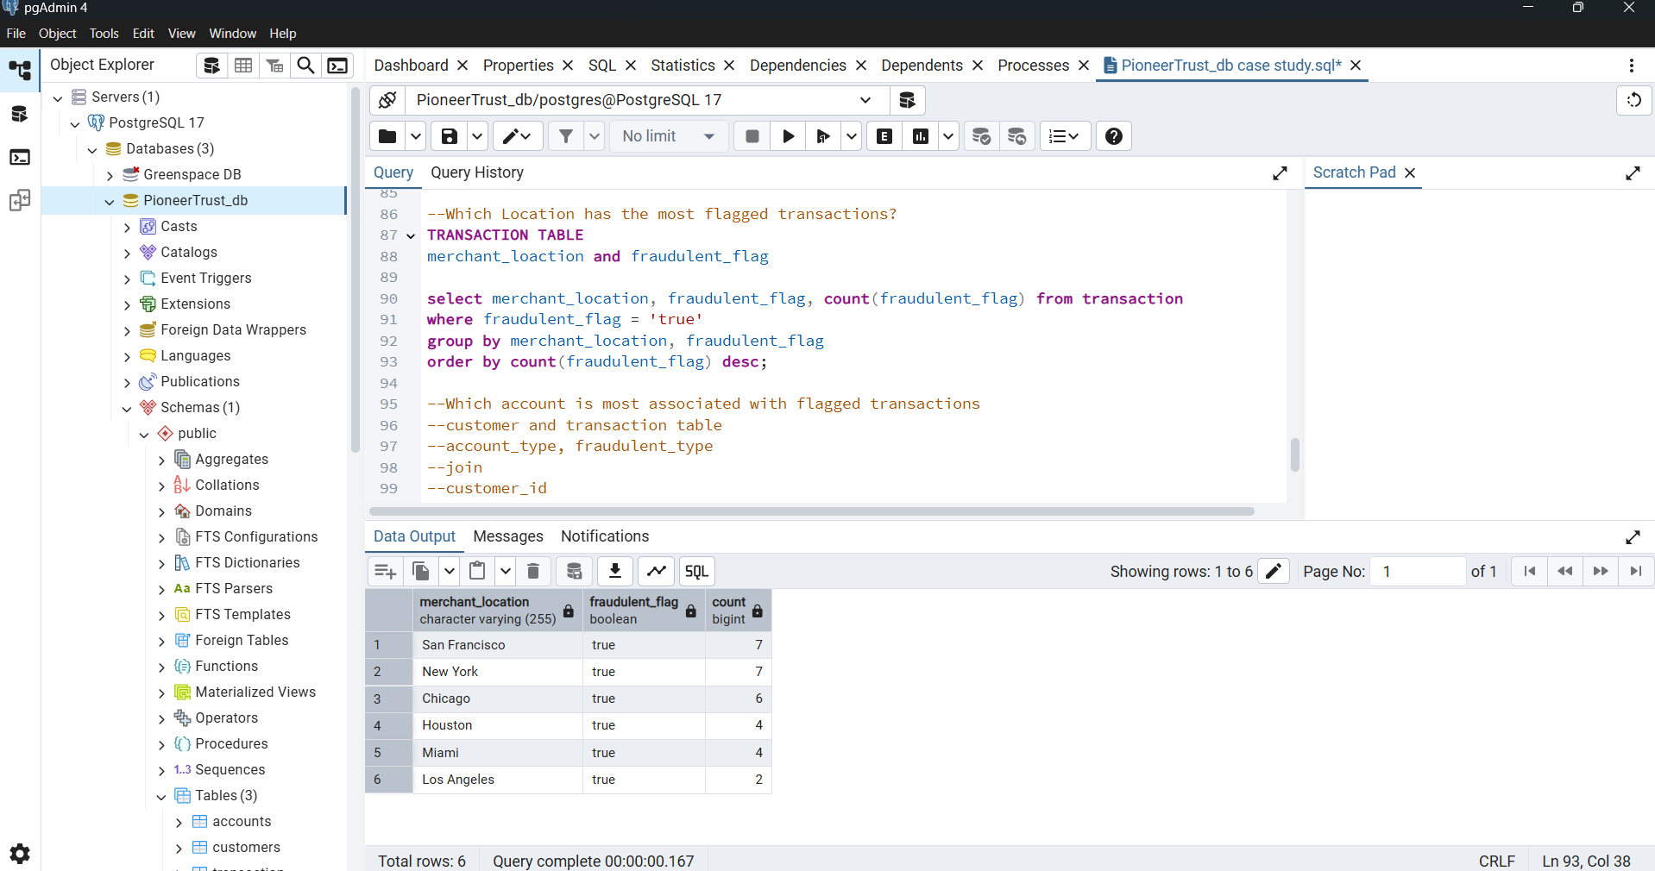
Transactions from Multiple Locations

Slide 13
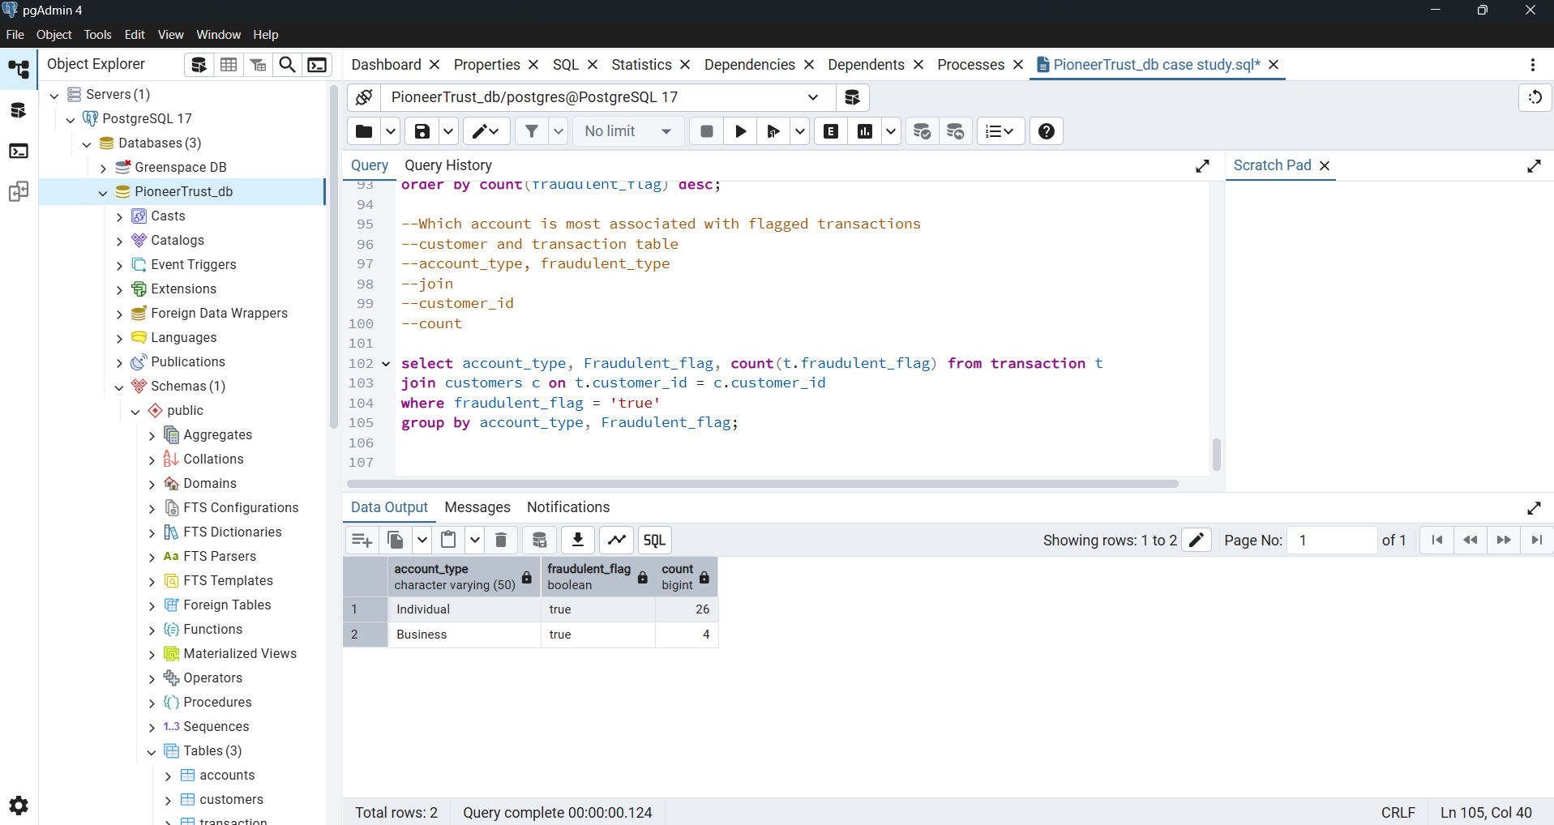
Transactions from Multiple Locations

Slide 14

Insight: Transactions from Multiple Locations
Objectives: Identify customers, account types, and transactions made from different geographical locations within short timeframes.
Finding:
Certain users (e.g., Jack Brown) made 4 transactions from different cities within one day.
Locations like San Francisco and New York had the highest concentration of flagged transactions.
Review KYC data and transaction histories of flagged Individuals.
Recommendation:
Introduce geo-fencing and IP-location consistency checks.
Alert system should flag abnormal travel-based transaction patterns.
Introduce two-factor authentication for transactions occurring from distant or new locations.

Slide 15
Conclusion & Recommendations
This project revealed critical insights using SQL on banking transaction data:
High-value transactions often exceed normal patterns and require threshold-based alerts.
Repeat offenders signal the need for automated profile-based blocking rules.
Multi-location transactions suggest account compromise and warrant geographic checks.
By combining these strategies, Pioneer Trust Bank can improve fraud detection, reduce losses, and restore customer trust.

Slide 16
Conclusion & Recommendations
The SQL-based analysis uncovered clear patterns of fraud risk:
High-value and repeat transactions are key fraud indicators.
Certain locations and individual account types are more fraud-prone.
Time-based and behavior-based monitoring is crucial for proactive fraud detection.

Slide 17
Next Steps for Management
Integrate automated alert systems for high-risk behaviors.
Enhance fraud prevention systems using geolocation and behavioral analytics.
Invest in staff training for fraud pattern recognition and anomaly detection.

Slide 18


